Slide 1
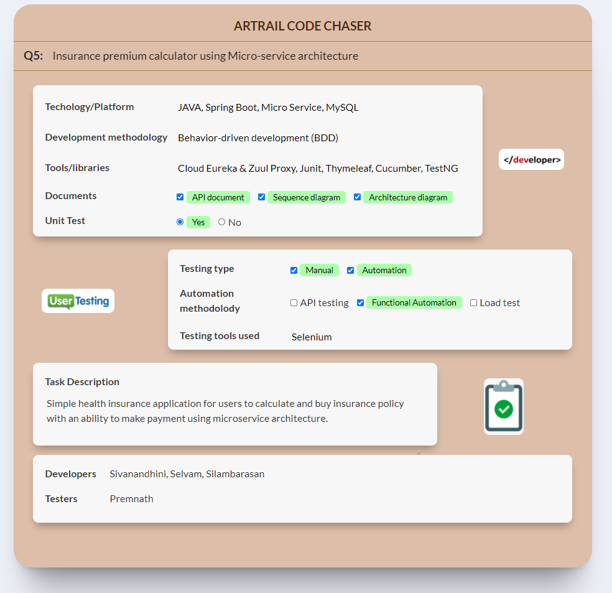

Slide 2
Insurance Premium Calculator

Slide 3
Highlights
Created health insurance application using micro service design pattern for calculating premium amount and to post the payment.
Created API-Gateway to establish synchronous communication between user to service and within micro service(s).
Flexible UI to calculate premium amount and to post the payment.
Followed the BDD approach with cucumber features, TestNG and generated the usage and overview report.
Automated various cases using selenium web driver, cucumber and Junit.

Slide 4
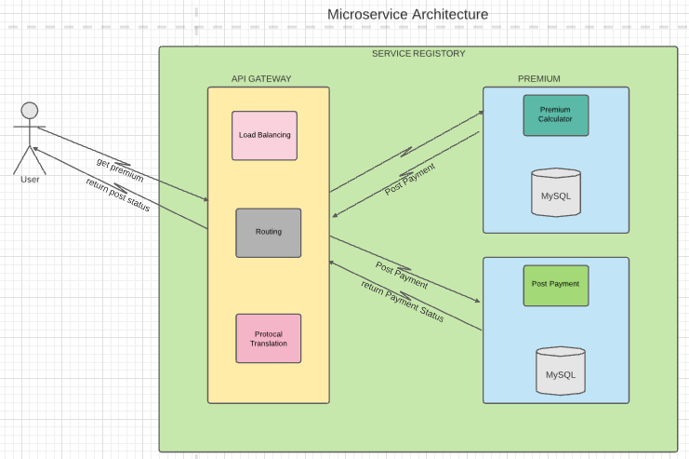
Architecture Diagram ( Service Registry, API-Gateway, Payment Service, Premium Service )

Slide 5
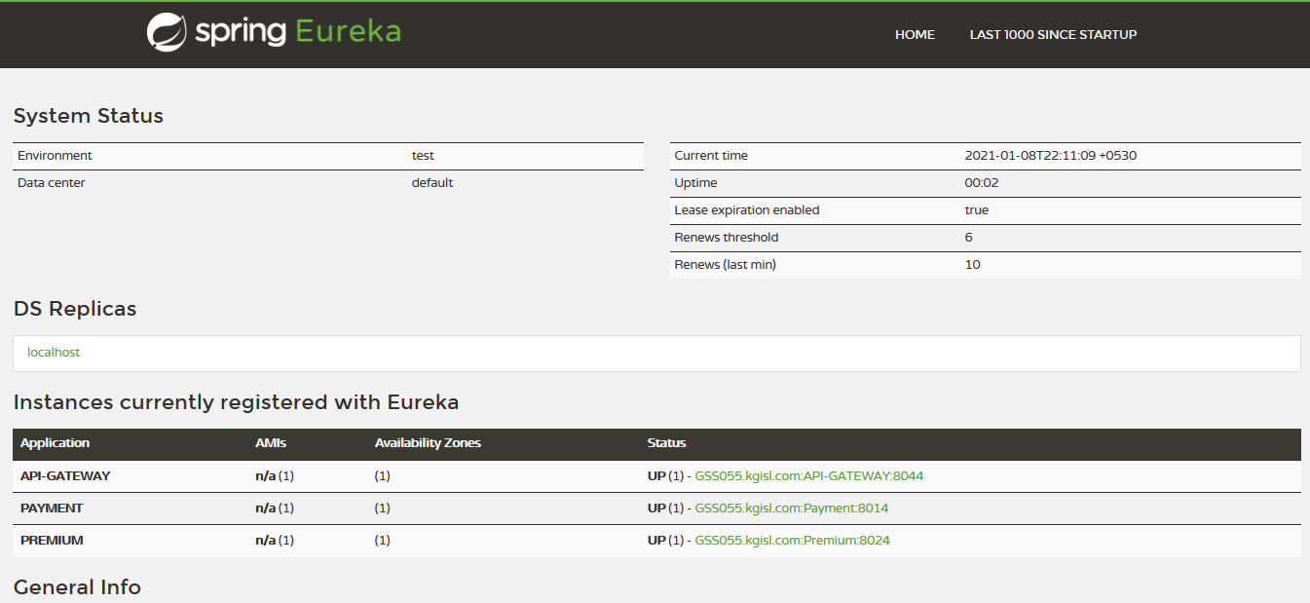
Service Registry ( Spring Eureka Server )

Slide 6
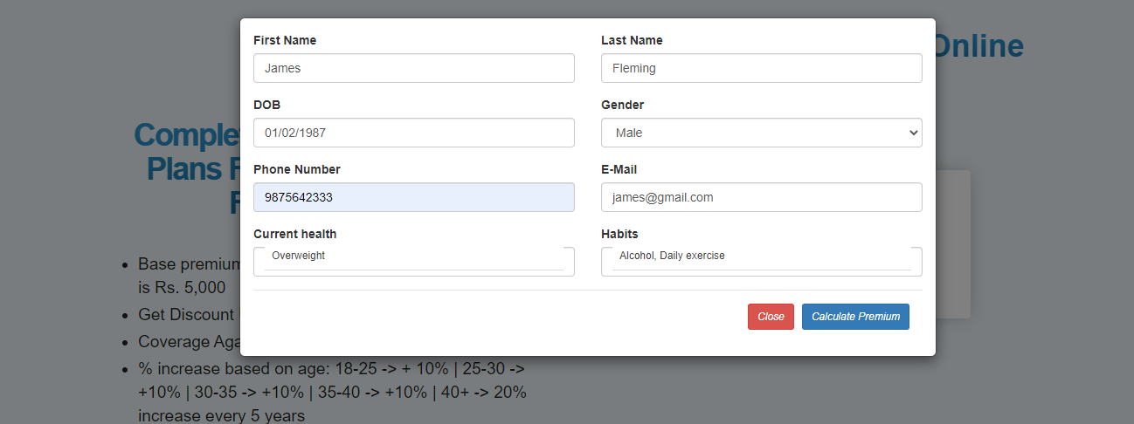
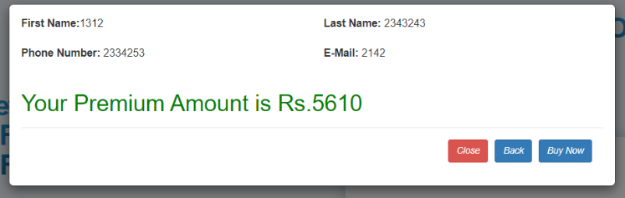
Premium Amount Calculator
Pop-up to get the person details

Slide 7
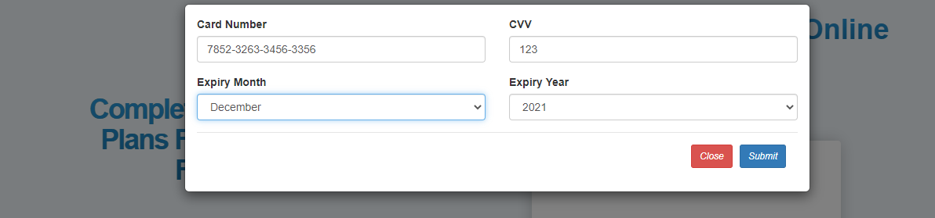

Premium Amount Posting
Card details popup

Slide 8
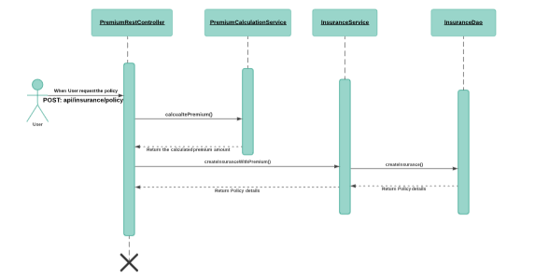
Sequence Diagram
Premium calculation & policy creation

Slide 9
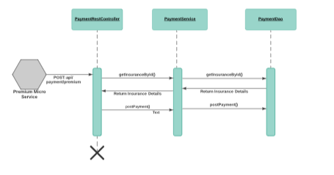
Sequence Diagram
Premium Payment Service

Slide 10
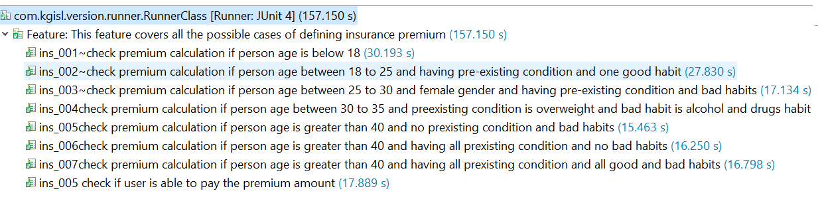
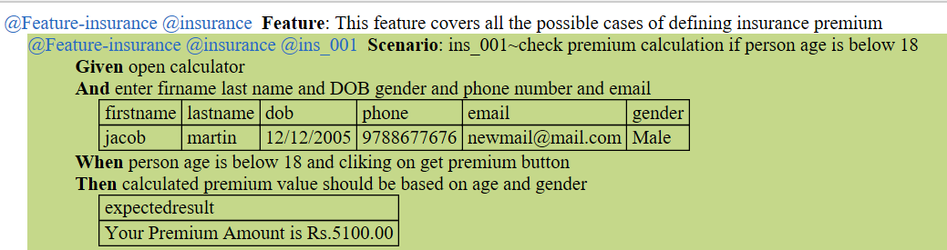
Functional Testing Report (Cucumber)

